Slide 1

Seasonal Agriculture Performance Analysis
NAME :- ABHAY YADAV
COLLEGE NAME:- RCC Institute of Information Technology
AICTE STU ID : STU6a6ad2679770b1785385575

Slide 2

PROBLEM STATEMENT
Agricultural activities are influenced by seasonal variations in environmental conditions, farming practices, resource availability and market conditions. As a result, agricultural performance may differ from one season to another. However, raw agricultural data does not clearly explain how agricultural performance changes across seasons or what patterns can be observed in different seasonal conditions. The problem is to analyze the given agricultural dataset and investigate seasonal differences in agricultural performance by identifying meaningful patterns, trends, relationships and variations within the available data

Slide 3
Project Description Analyzed 4,000 agricultural records to identify seasonal patterns in crop yield, profit, water usage, and environmental conditions using Python, Pandas, Matplotlib, and Seaborn. Developed data-driven insights and recommendations for improving agricultural performance.

Slide 4

WHO ARE THE END USERS?
The end users are
Farmers
Agricultural planners
Agricultural researchers
Agribuisinesses

Slide 5

Technology Used
Python
Google colab
Pandas
Numpy
Matplotlib
Seaborn
CSV dataset

Slide 6
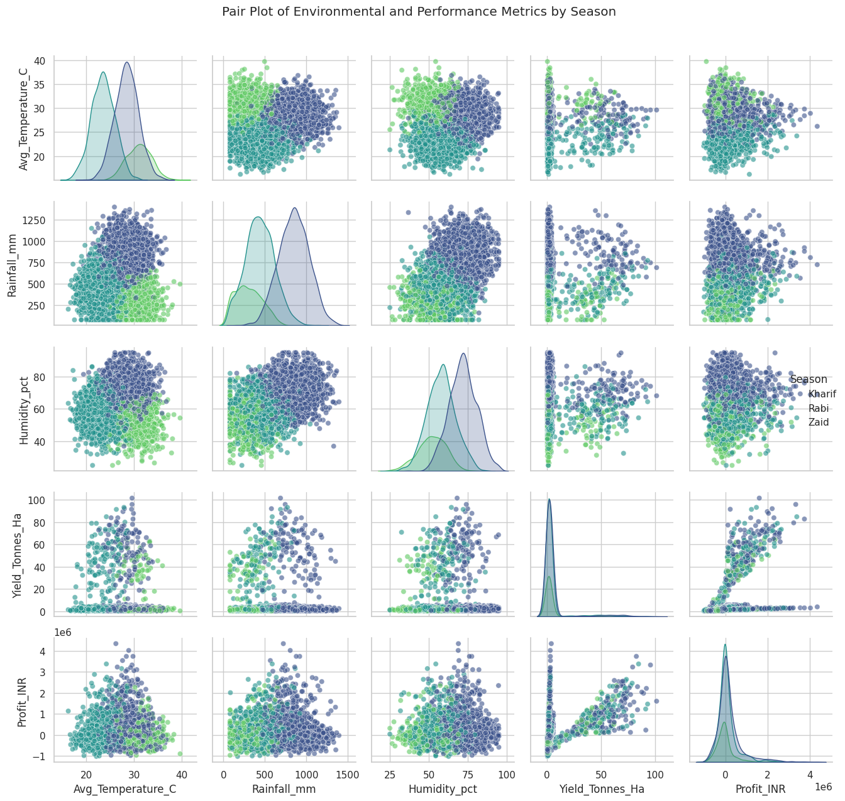

RESULTS
The pair plot shows relationships between temperature, rainfall, humidity, yield, and profit across different seasons.
Kharif, Rabi, and Zaid are shown using different colors.
It helps identify relationships and patterns between environmental conditions and agricultural performance.
Yield and profit vary across seasons, with Kharif generally showing better performance.
The plot shows that environmental factors such as rainfall and temperature vary by season.
The diagonal graphs show the distribution of each variable

Slide 7
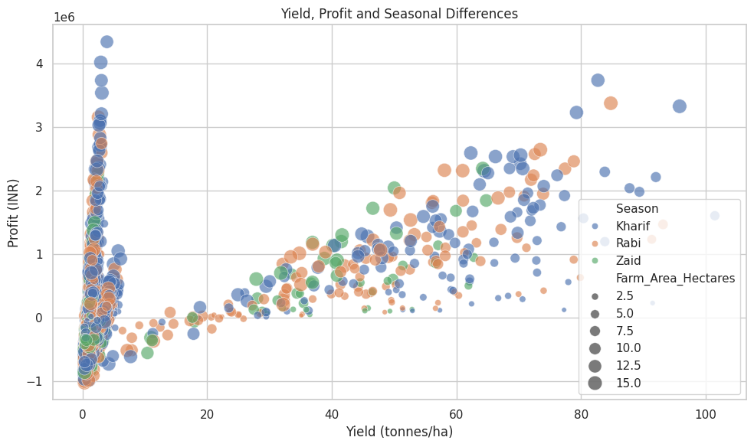
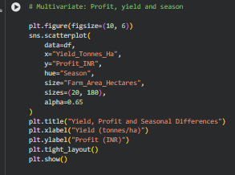
RESULTS
The scatter plot shows the relationship between Yield and Profit for different seasons.
Kharif: Generally shows higher yield and higher profit.
Rabi: Shows moderate yield and profit.
Zaid: Generally has lower yield and often lower/negative profit.
The bubble size represents farm area — bigger bubbles mean larger farms.
The graph helps compare whether higher yield is associated with higher profit across seasons.

Slide 8
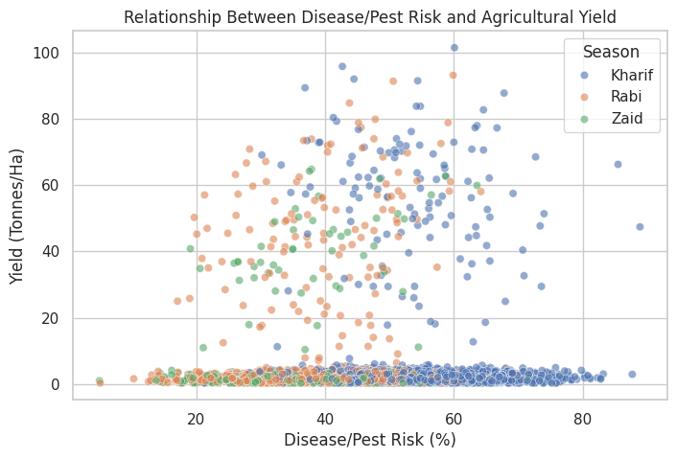
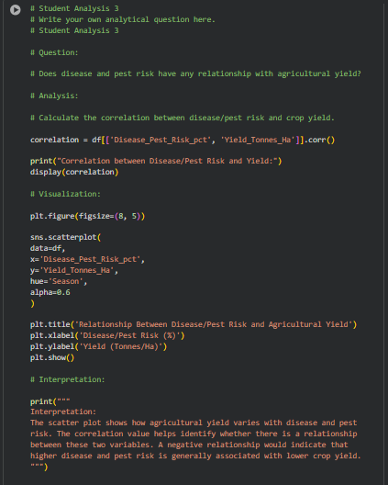
RESULTS

Slide 9
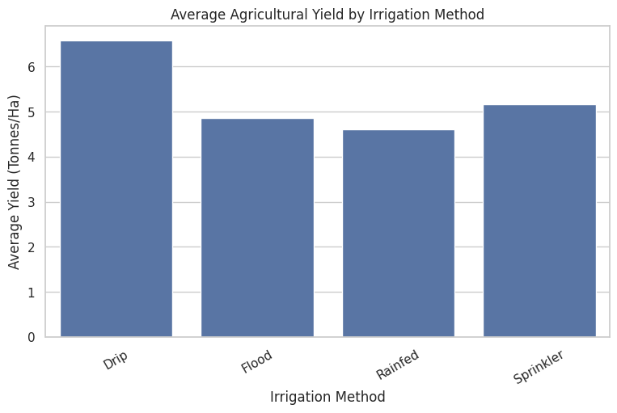
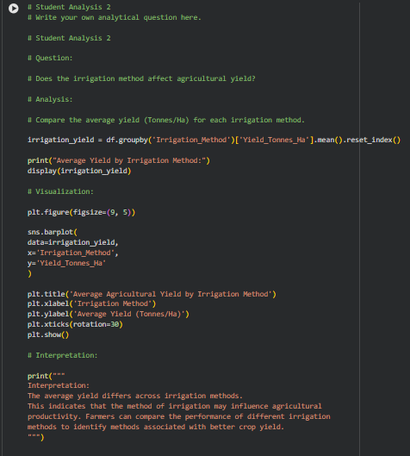
RESULTS

Slide 10
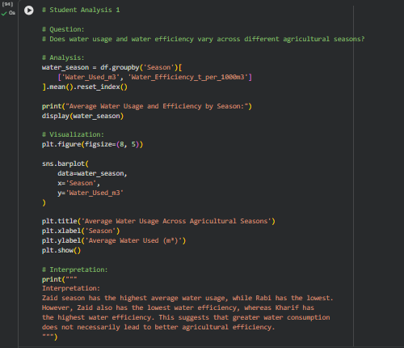
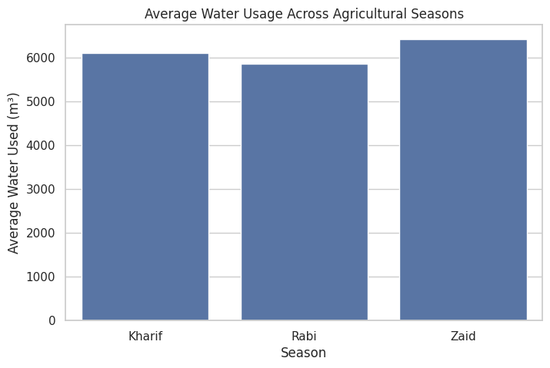
RESULTS

Slide 11
Future scope
Real-time agricultural data integration
Crop and region-wise analysis
Yield and profit prediction
Smart irrigation recommendations
Interactive dashboard development

Slide 12
GitHub Link
https://github.com/ece2023092-cloud/seasonal_agriculture_performance.git

Slide 13
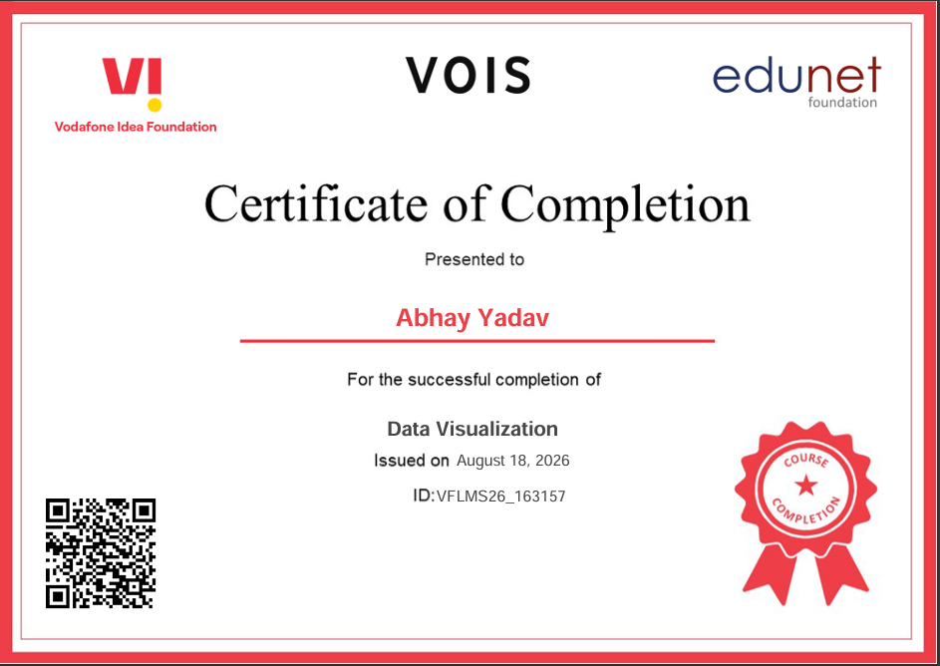
VOIS Course completion certificate - Course name- Data Visualization

Slide 14
Thank you
.
.

